Slide 1

Web/iOS Development
Shyne
2014.10.14

Slide 2

Today
From previous class
  Use AirDrop to wirelessly share content
  http://support.apple.com/kb/ht5887
  Hello world image background
Object oriented programming - basics
UI components
  View controllers
  Views
Demo
  Build autolist using storyboard

Slide 3
[Basic OO Concept]

Slide 4
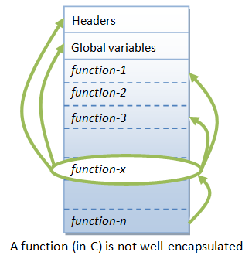
Traditional procedural-oriented languages
The programs are made up of functions. Functions are often not reusable.
The procedural languages are not suitable of high-level abstraction for solving real life problems.

Slide 5
Object oriented programming
OOP represents the concept of "objects" that have data fields (attributes that describe the object) and associated procedures known as methods.
Objects, which are usually instances of classes, are used to interact with one another to design applications and computer programs.
https://www.youtube.com/watch?v=SZqLEDH0x7A

Slide 6
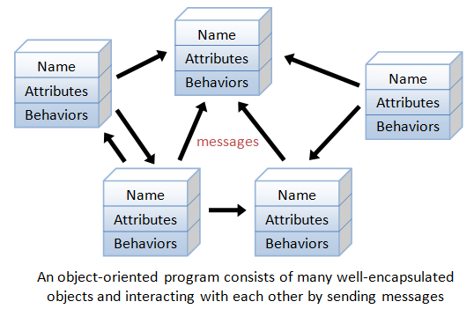
Object examples
The basic unit of OOP is a class, which encapsulates both the static attributes and dynamic behaviors within a "box", and specifies the public interface for using these boxes.
Since the class is well-encapsulated (compared with the function), it is easier to reuse these classes. In other words, OOP combines the data structures and algorithms of a software entity inside the same box.

Slide 7
A real world example
Bank
  Desk clerk
  Supervisor
  Customer
  Counter
  Take a number dispenser

Slide 8
Benefits of OOP
Ease in software design as you could think in the problem space rather than the machine's bits and bytes. You are dealing with high-level concepts and abstractions. Ease in design leads to more productive software development.
Ease in software maintenance: object-oriented software are easier to understand, therefore easier to test, debug, and maintain.
Reusable software: you don't need to keep re-inventing the wheels and re-write the same functions for different situations. The fastest and safest way of developing a new application is to reuse existing codes - fully tested and proven codes.

Slide 9
Object: class and instance
Class
  A class is a definition of objects of the same kind. In other words, a class is a blueprint, template, or prototype that defines and describes the static attributes and dynamic behaviors common to all objects of the same kind.
Instance
  An instance is a realization of a particular item of a class. In other words, an instance is an instantiation of a class. All the instances of a class have similar properties, as described in the class definition. For example, you can define a class called "Student" and create three instances of the class "Student" for "Peter", "Paul" and "Pauline".

Slide 10
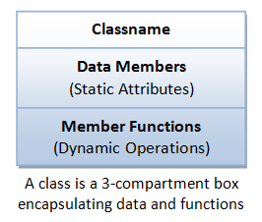
Classes
A class can be visualized as a three-compartment box, as illustrated:
  Class name (or identifier): identifies the class.
  Data Members or Variables (or attributes, states, fields): contains the static attributes of the class.
  Member Functions (or methods, behaviors, operations): contains the dynamic operations of the class.
In other words, a class encapsulates the static attributes (data) and dynamic behaviors (operations that operate on the data) in a box.
Class Members: The data members and member functions are collectively called class members.

Slide 11
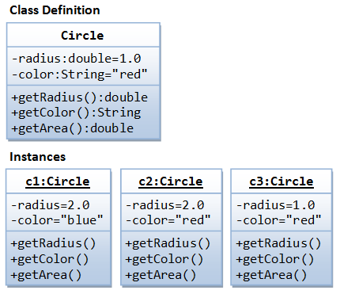
Object: class and instance

Slide 12
Exercise - object: class and instance
Fill up bank objects
  Desk clerk
  Supervisor
  Customer
  Counter
  Take a number dispenser

Slide 13
[Objective C]

Slide 14
About Objective-C
Objective-C is the primary programming language you use when writing software for OS X and iOS.
It’s a superset of the C programming language and provides object-oriented capabilities and a dynamic runtime.
Objective-C inherits the syntax, primitive types, and flow control statements of C and adds syntax for defining classes and methods.
It also adds language-level support for object graph management and object literals while providing dynamic typing and binding, deferring many responsibilities until runtime.

Slide 15
Overview
An App is built from a network of objects
Categories extend existing classes
Protocols define messaging contracts
Values and Collections are often represented as Objective-C objects
Blocks simplify common tasks
Error objects are used for runtime problems
Objective-C code follows established conventions
  Method names, for example, start with a lowercase letter and use camel case for multiple words; for example, doSomething or doSomethingElse

Slide 16
Class definition
An app is built as a large ecosystem of interconnected objects that communicate with each other to solve specific problems, such as displaying a visual interface, responding to user input, or storing information. For OS X or iOS development, you don’t need to create objects from scratch to solve every conceivable problem; instead you have a large library of existing objects available for your use, provided by Cocoa (for OS X) and Cocoa Touch (for iOS).
Some of these objects are immediately usable, such as basic data types like strings and numbers, or user interface elements like buttons and table views.
Class names must be unique
  Each class must be unique within an app, even across included libraries or frameworks. If you attempt to create a new class with the same name as an existing class in a project, you’ll receive a compiler error.

Slide 17
Class interface
In Objective-C, the class interface specifies exactly how a given type of object is intended to be used by other objects. In other words, it defines the public interface between instances of the class and the outside world.

Slide 18
Example: NSString
For a string object (in Objective-C, this is an instance of the class NSString), the class offers various ways to examine and convert the internal characters that it represents
Help page
  https://developer.apple.com/library/prerelease/iOS/documentation/Cocoa/Reference/Foundation/Classes/NSString_Class/index.html
You might know that a string object represents some string of characters, but you don’t need to know the exact internal mechanisms used to store those characters. You don’t know anything about the internal behavior used by the object itself to work directly with its characters, but you do need to know how you are expected to interact with the object, perhaps to ask it for specific characters or request a new object in which all the original characters are converted to uppercase.

Slide 19
Mutability
Mutability determines whether a represented value can be changed
This means that the internal contents must be set when an object is created, and cannot subsequently be changed by other objects. In Objective-C, all basic NSString and NSNumber objects are immutable. If you need to represent a different number, you must use a new NSNumber instance.
Some immutable classes also offer a mutable version
For example by appending characters as they are received over a network connection, you can use an instance of the NSMutableString class. Instances of this class behave just like NSString objects, except that they also offer functionality to change the characters that the object represents.
https://developer.apple.com/library/ios/documentation/Cocoa/Reference/Foundation/Classes/NSMutableString_Class/

Slide 20
[UI Components]

Slide 21
UIKit Framework
https://developer.apple.com/library/ios/documentation/Uikit/reference/UIKit_Framework/index.html

Slide 22
[Autolist]

Slide 23
Homework
Implement real app with your storyboard from last week.

Slide 24
~ END ~
http://www.alphacamp.tw

